Slide 1
FINAL PROJECT
COMPUTER INFORMATION TECHNOLOGY

Slide 2





MY RESUME
CONSISTS OF FIVE SECTIONS WHICH INCLUDES MY ACADEMIC AND PROFESSIONAL DETAILS

Slide 3
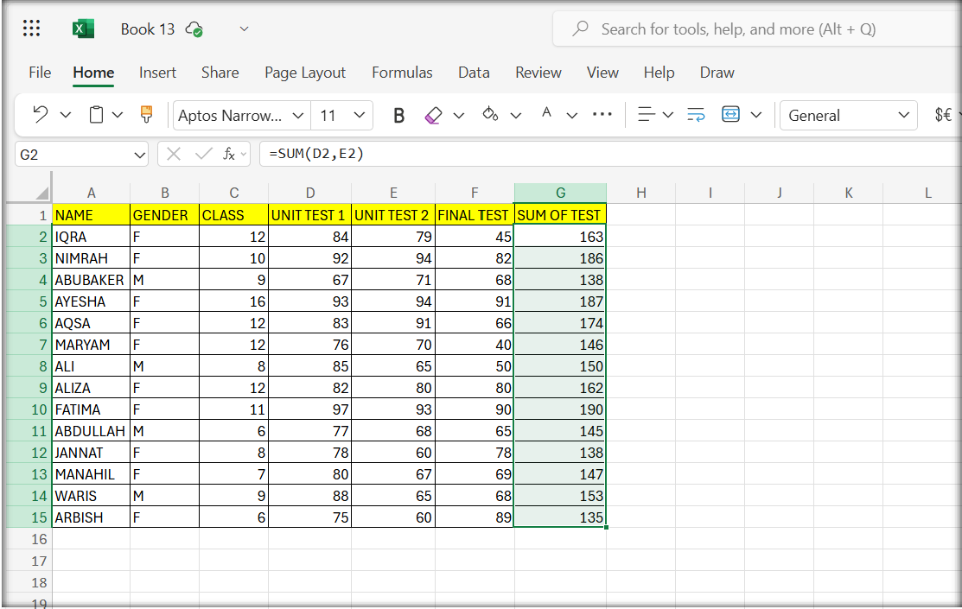
SUM IN EXCEL
THE SUM IN EXCEL,USE THE SUM FUNCTION(E.G; =SUM(D2,E2)) BY TYPING THE FORMULA INTO A CELL & PRESSING ENTER

Slide 4
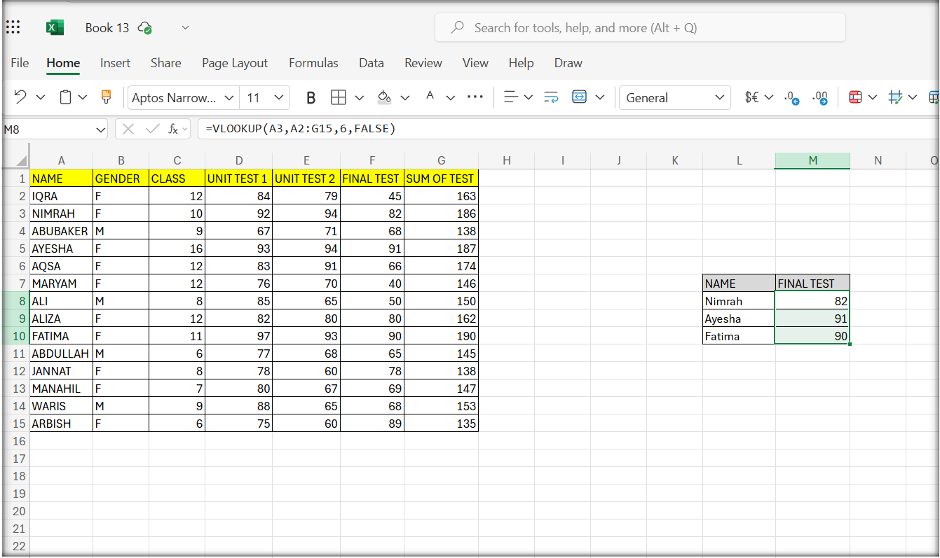
VLOOKUP FORMULA
VLOOKUP IN EXCEL IS USED TO LOOKUP A CERTAIN VALUE IN ANY COLUMN
=V;OOKUP(LOOKUP_VALUE,TABLE_ ARRAY,COL_INDEX_NUM,RANGE LOOKUP (TRUE OR FALSE)

Slide 5
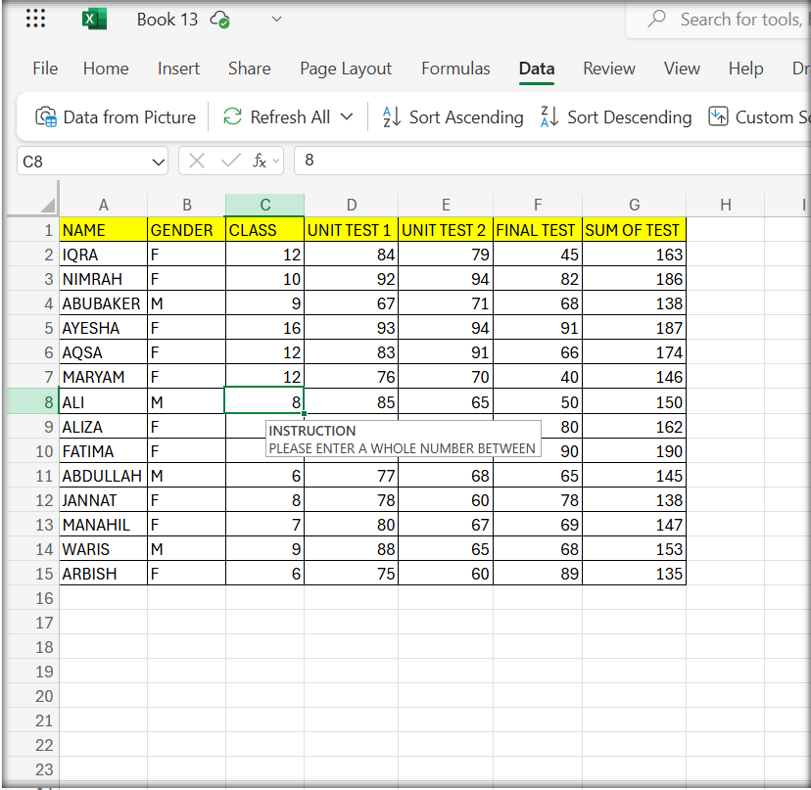
DATA VALIDATION
DATA VALIDATION RESTRICTED TO ONLY ENTER A NUMBER BETWEEN 9 TO 16 & WHEN YOU ENTER ANOTHER NUMBER GET ON ERROR

Slide 6
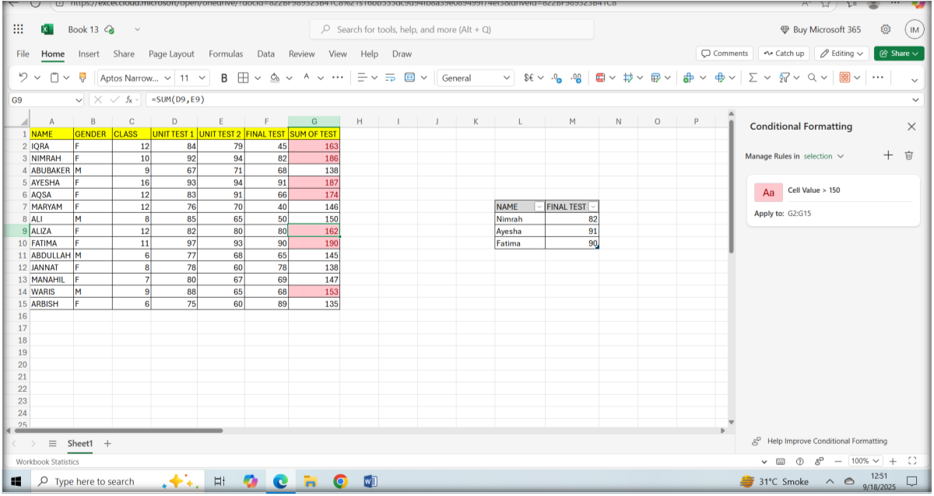
CONDITIONAL FORMATTING
CONDITIONAL FORMATTING AUTOMATICALLY APPLIES VISUAL STYLES, LIKE COLORS, DATA BARS OR ICONS, TO CELLS BASED ON SPECIFIC RULES OR CONDITIONS

Slide 7
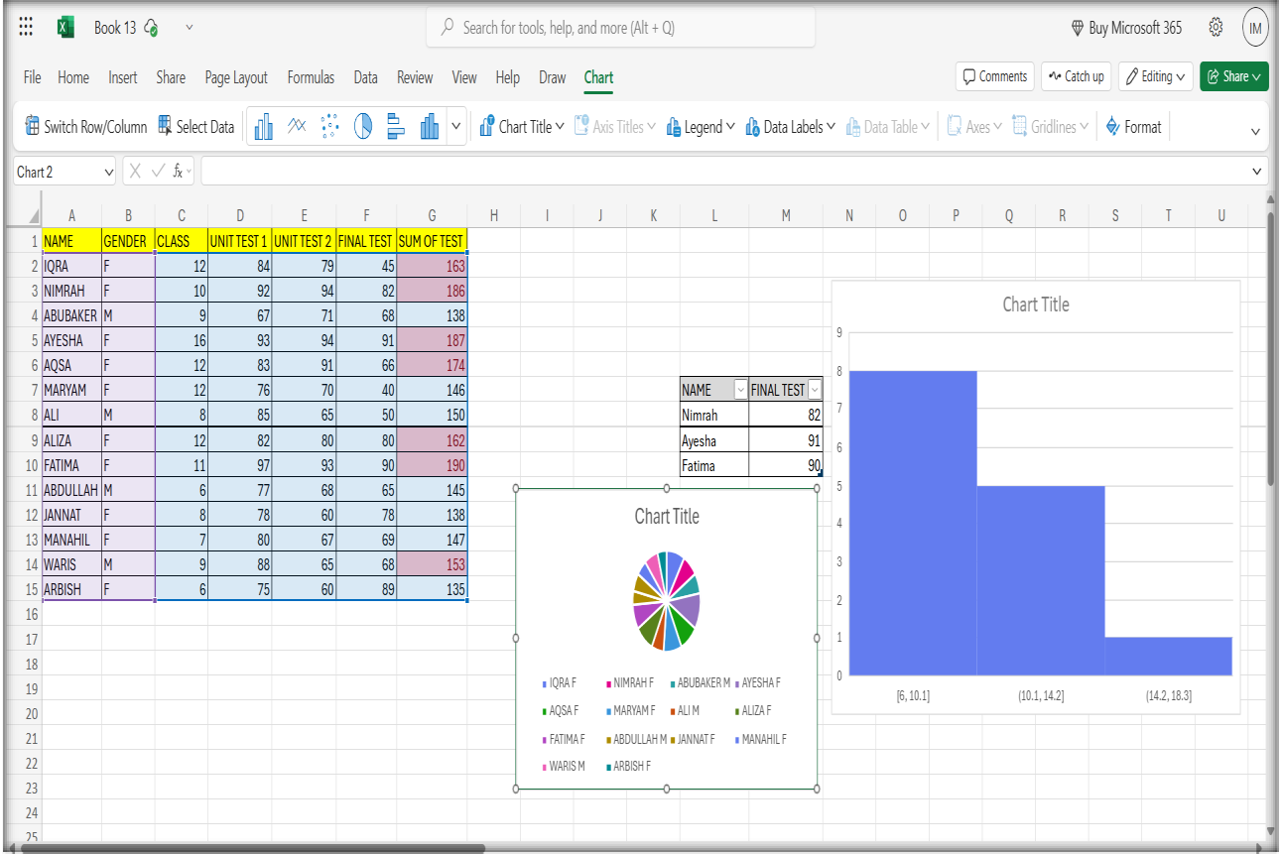
CHARTS
CHARTS GRAPHICAL REPRESENTATIONS OF NUMERICAL DATA, USED TO VISUALIZE TRENDS, PATTERNS, & RELATIONSHIP THAT MIGHT BE DIFFICULT TO SEE IN A SPREADHEET

